Slide 1

Energy Isolation Required for Multi-tenant Energy Harvesting Platforms
Branden Ghena
Joshua Adkins, Bradford Campbell, Branden Ghena, Neal Jackson, Pat Pannuto, & Prabal Dutta
ENSsys’17
November 5, 2017 - Delft, Netherlands

Slide 2
It’s time to start thinking about energy-harvesting and multi-tenancy together
How do we support multiple unaligned applications while also balancing limited energy availability?
We need to address energy sharing, isolation, and adaptivity

Slide 3
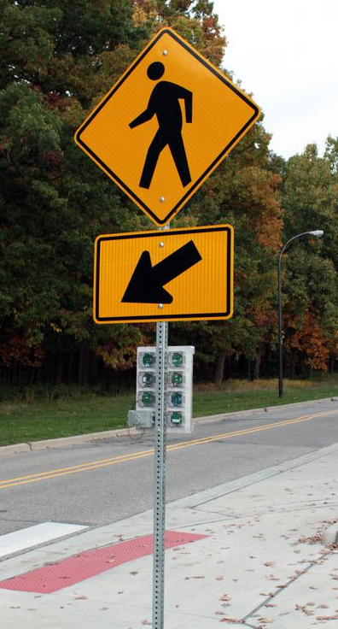
Motivation: The Signpost Platform
Enabling city-scale sensing applications
Platform provides base services
Modules run applications and include sensors
Infrastructure-free infrastructure
Solar energy harvesting
Multiple wireless networking options
Easy (two bolt) installation

Slide 4
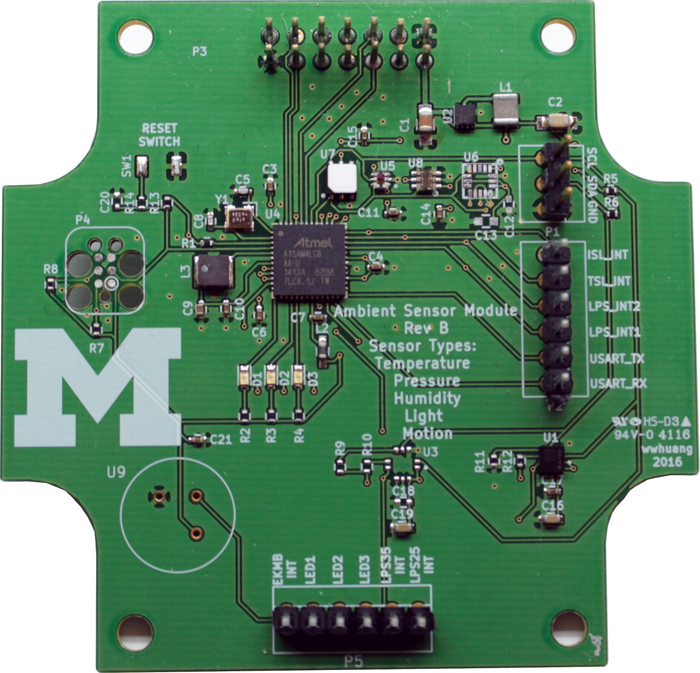
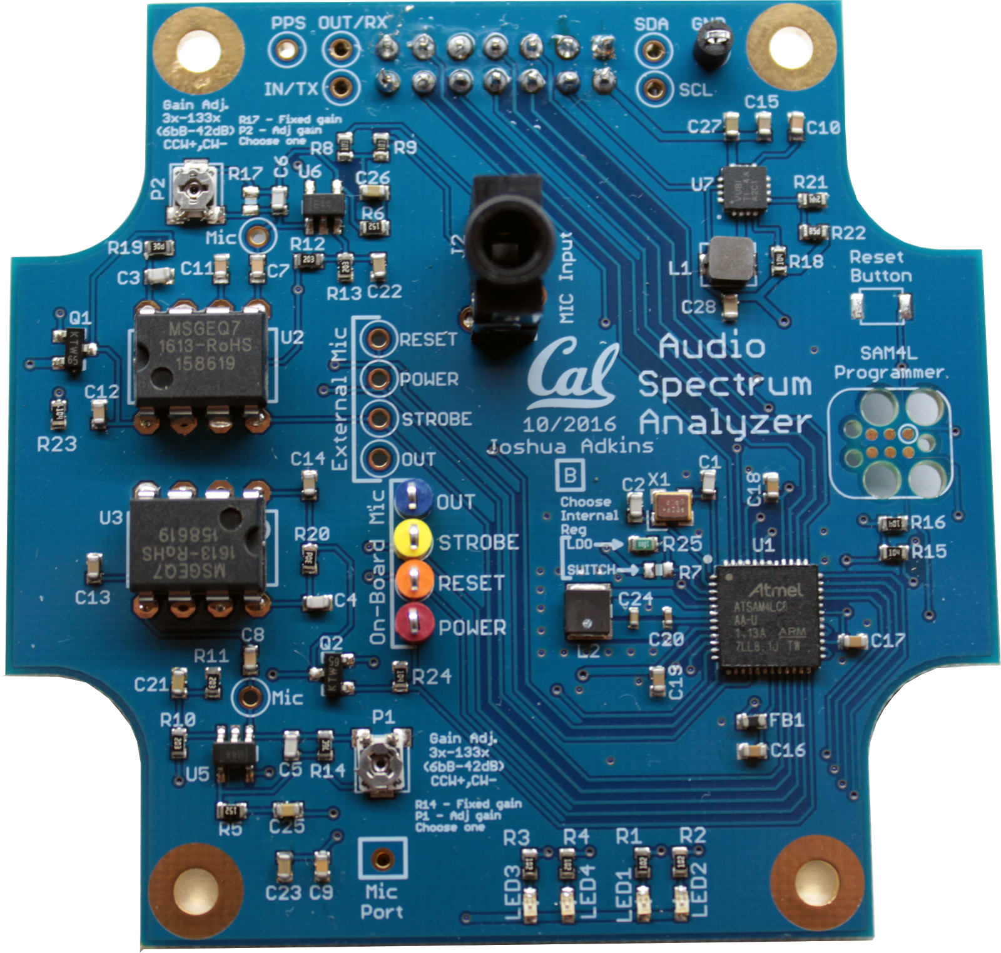
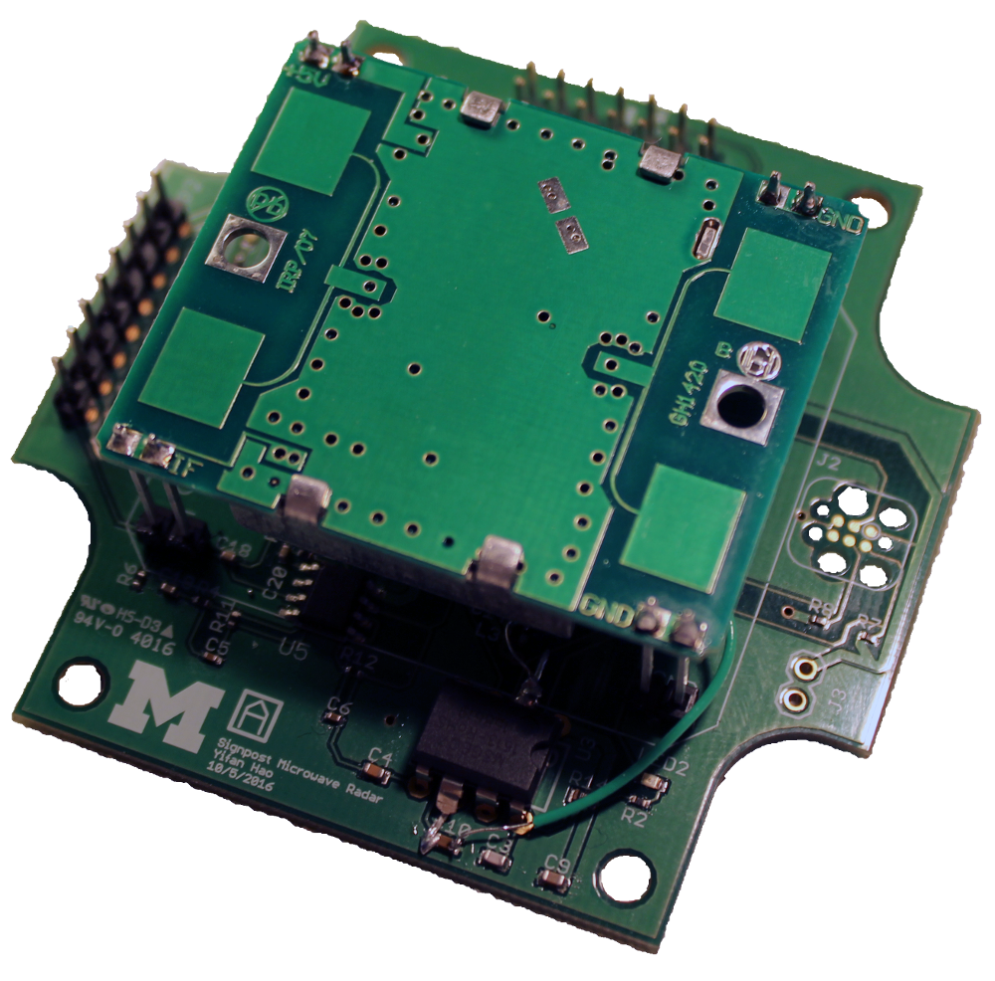
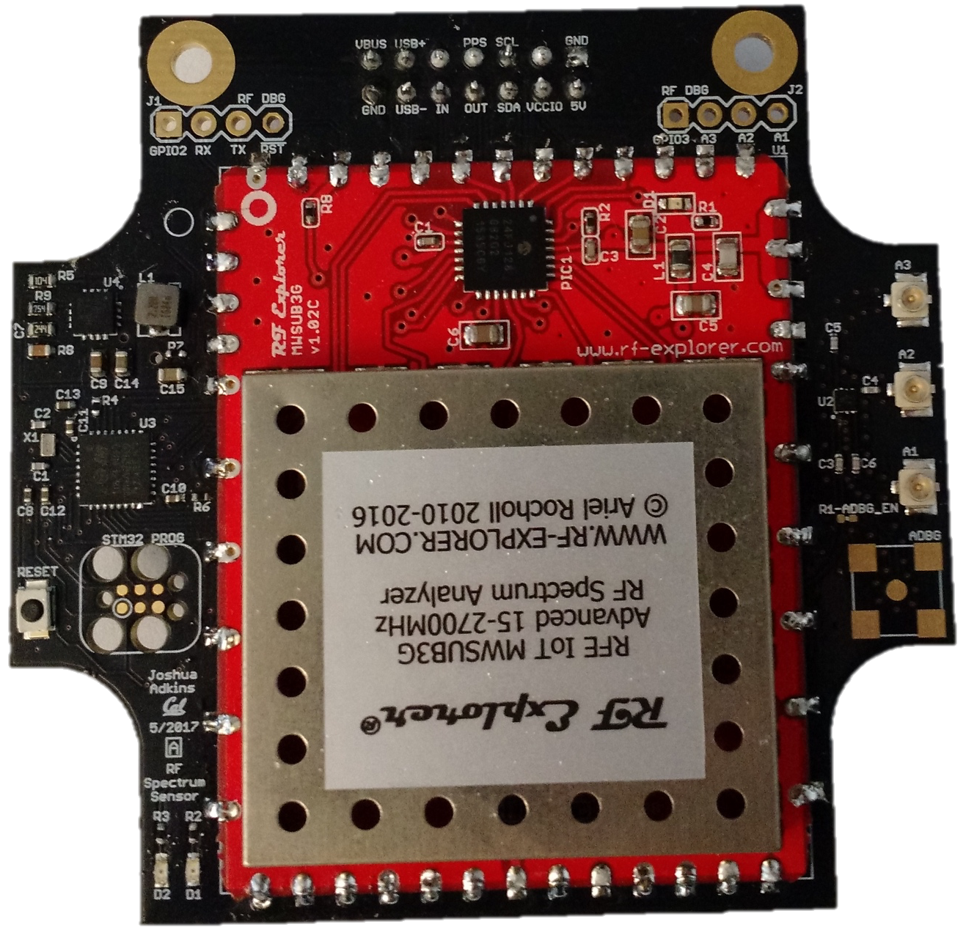
Signpost expects a variety of applications
RF Spectrum Use Measurement
Audio Analysis
Environmental Sensing
Motion Detection

Slide 5
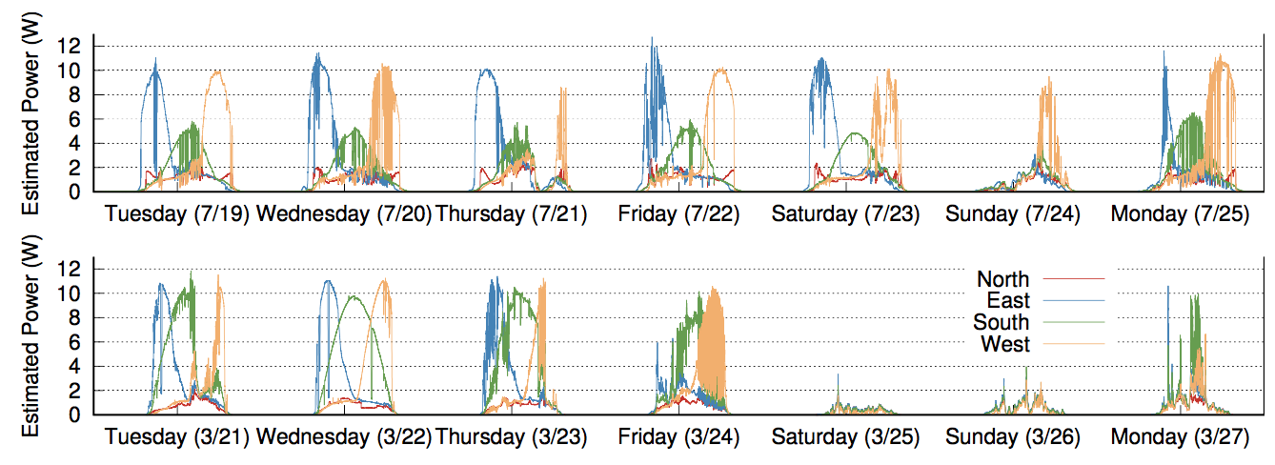
Signpost expects energy variability
Daily average varies between 2.7 W and 0.09 W

Slide 6
Design requirements for Signpost
Energy on Signpost is shared between applications
Needs individual module energy use measurements
Needs individual module power control
Needs to measure and charge for service usage
Needs to allocate incoming energy among applications
Platform needs to enable adaptable applications
Expects to be deployed with varying energy availability
Applications can’t be re-written for each Signpost

Slide 7
Multiprogramming is coming to single-microcontroller systems too
Systems like Tock and Amulet provide multi-tenancy on low-power, resource-constrained systems
These systems bring new challenges
Applications may be even further decoupled from the hardware
Fine-grained measurements of energy use may be difficult
The platform needs to account for and be able to reset external state

Slide 8
How do we enable application reasoning?
Guarantee: allocated energy may only decrease predictably
The application may run and use the energy
Services may be used that charge against the application
The platform may charge a constant upkeep cost
Allow applications to plan for the worst-case future

Slide 9
How should energy be allocated to applications?
Simple: Divide evenly between virtual allocations
Complex: Use energy allocation as a form of priority
Design questions
Need to decide how much energy each application can store
Need to decide how frequently to apportion incoming energy
Lack of care leads to intermittent operation

Slide 10
Discussion
How do we make energy-limited programming accessible to developers?
Allocation guarantees enable reasoning, but only if applications can access and interpret their energy availability
Do we really want application developers to have to reason about their energy?
Is run-to-completion at a varying frequency the only model that works here?
Notes:
Signpost: applications can request a duty cycle, made an API for measurement of ”operation” energy use

Slide 11
Discussion
How do we enable developers to understand how code is functioning at runtime?
Is compile-time analysis still helpful in a multiprogramming scenario?
How do you report runtime performance of applications?
How do you know in advance that a certain combination of applications is going to have undesirable results?
Notes:
Signpost:

Slide 12
Discussion
When is state-based profiling an accurate enough as a measure of application energy use?
Putting energy gauges everywhere is unlikely for many platforms
Accurately sharing a hardware resource, like a radio, is difficult even with an individual gauge
Notes:
Signpost:

Slide 13
Discussion
What reliability guarantees can we expect from energy-harvesting systems?
How do you distinguish failure from lack of energy?
Can we include energy-harvesting systems in user facing applications?
Notes:
Signpost:

Slide 14

For More Information…
https://github.com/lab11
lab11/signpost [hardware design files]
lab11/signpost-software [software repository]
https://github.com/helena-project/tock
Email: brghena@berkeley.edu
Notes:
Our lab website is down. Lame ☹

